Slide 1
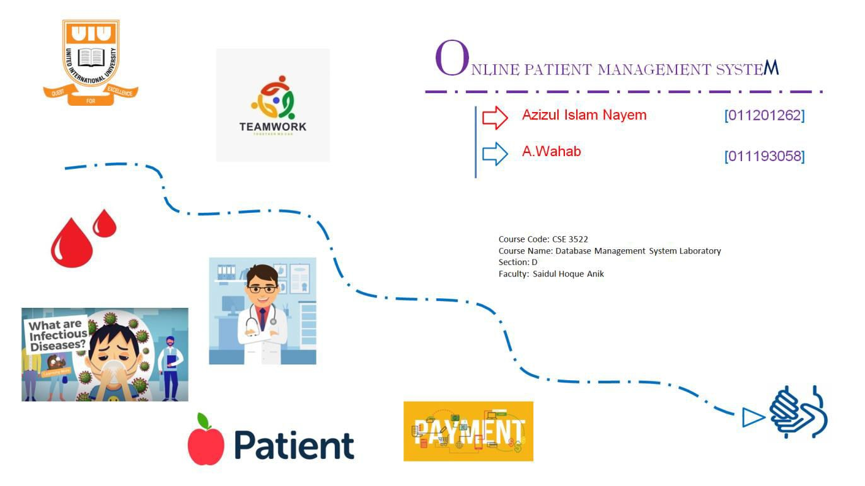
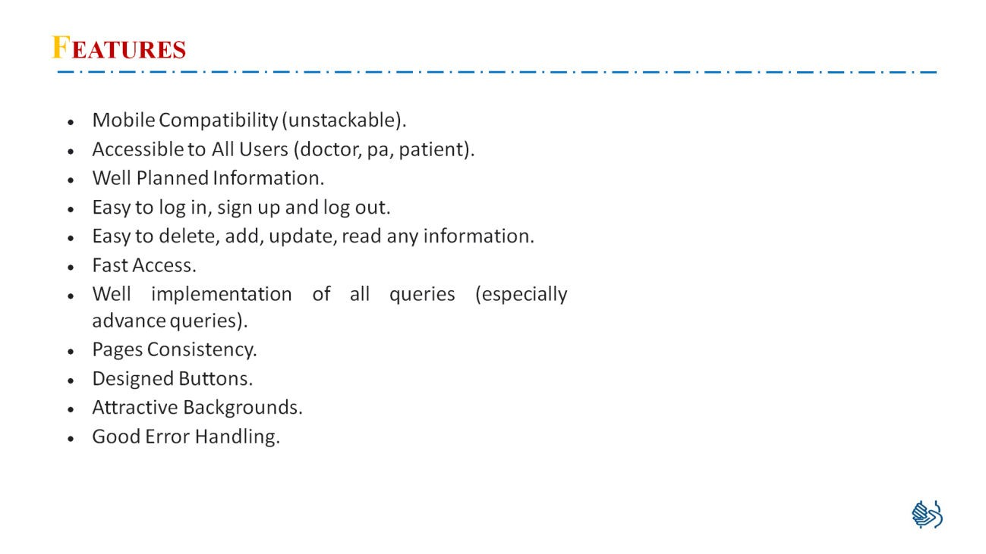
Online Patient Management System

Slide 2
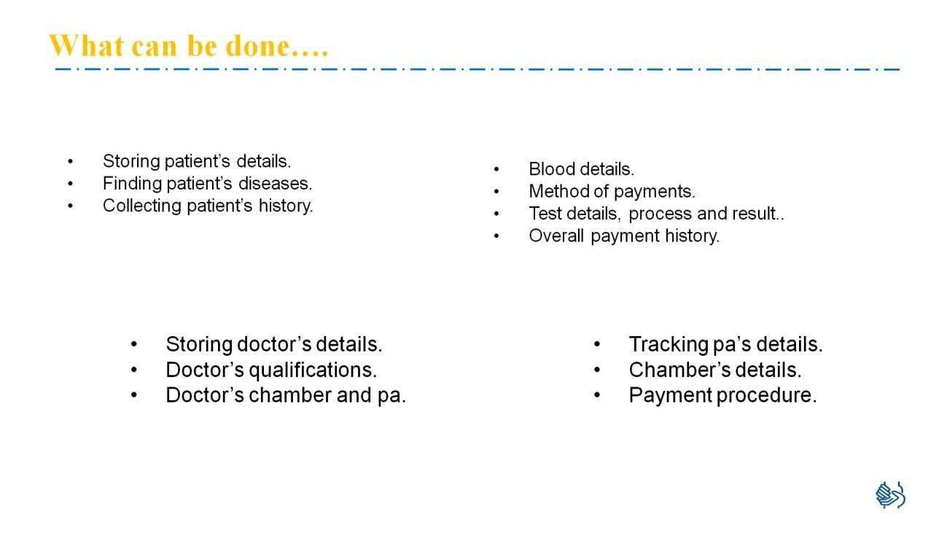
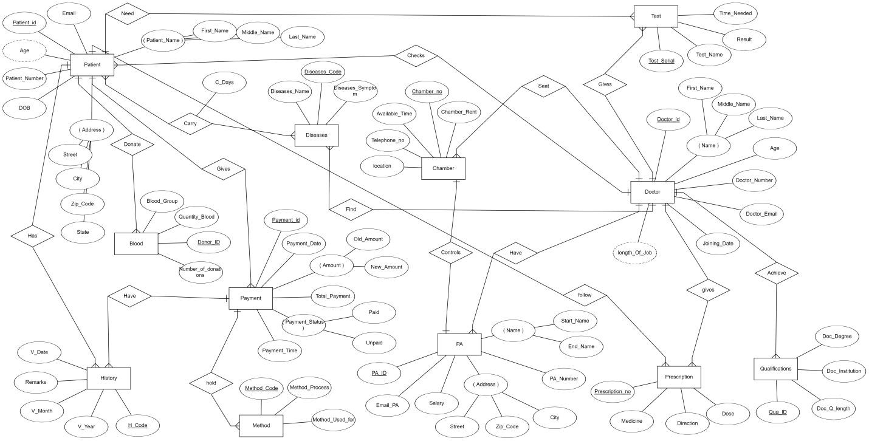
Online Patient Management System
ERD:

Slide 3
Online Patient Management System
Azizul Islam Nayem(011201262) All Tables:
………………..
Doctor
Qualifications
Pa
Patient
Diseases
Test
All Queries: INSERT
.................
INSERT INTO doctor VALUES ( NULL, '$fn', '$mn','$ln','$age','$dn','$de','$jd'); INSERT INTO qualifications VALUES ('$dql','$dd','$di',NULL,'$did');
INSERT INTO pa VALUES ($sa, '$ep','$sn','$en','$pn','$st','$zc','$c',NULL,$doi);
INSERT INTO patient VALUES ( NULL,'$e', '$dob','$fn','$mn','$ln','$pn','$st','$c','$zc','$sta',$did); INSERT INTO diseases VALUES ('$din', NULL,'$ds',$docid);
INSERT INTO test VALUES ( '$tn', '$r','$tin',NULL,$pid,$did);
SELECT
..........................
SELECT * FROM doctor; SELECT * FROM qualifications;
SELECT * FROM pa;
SELECT * FROM patient; SELECT * FROM diseases; SELECT * FROM test;

Slide 4
Online Patient Management System
DELETE
...................
DELETE FROM doctor WHERE Doctor_id=$Doctor_id; DELETE FROM qualifications WHERE Qua_ID=$Qua_ID; DELETE FROM pa WHERE PA_ID=$PA_ID;
DELETE FROM patient WHERE Patient_id=$Patient_id;
DELETE FROM diseases WHERE Diseases_Code=$Diseases_Code; DELETE FROM test WHERE Test_Serial=$Test_Serial;
UPDATE
...............
UPDATE doctor SET First_Name='$fname', Middle_Name='$mname', Last_Name='$lname', Age='$age', Doctor_Number='$dno' , Doctor_Email='$dem' , Joining_Date='$jdate' WHERE Doctor_id = $id;
UPDATE qualifications SET Doc_Q_length='$dol', Doc_Degree='$dd', Doc_Institution='$di', Doctor_id='$did' WHERE Qua_ID = $id;
UPDATE pa SET Salary='$s', Email_PA='$ep', Start_Name='$sn', End_Name='$en', PA_Number='$pn' , Street='$st' , Zip_Code='$zp', City='$c', Doctor_id='$did' WHERE PA_ID = $id;
UPDATE patient SET Email='$e', DOB='$dob', First_Name='$fn', Middle_Name='$mn', Last_Name='$lm' , Patient_Number='$pn' , Street='$st',City='$c', Zip_Code='$zc', State='$sta' , Doctor_id='$did' WHERE Patient_id = $id;
UPDATE diseases SET Diseases_Name='$dn', Diseases_Symptom='$ds', Doctor_id='$did' WHERE Diseases_Code = $id;
UPDATE test SET Test_Name='$tn', Result='$r', Time_Needed='$tin', Patient_id='$pid', Doctor_id='$did' WHERE Test_Serial = $id;

Slide 5
Online Patient Management System
AGRREGATIONS
................
SELECT COUNT(*) c FROM doctor;
SELECT Max(salary) c,Sum(salary) s FROM pa;
JOIN
..................
SELECT d.Doctor_Email,q.Doc_Institution FROM doctor d JOIN qualifications q USING(Doctor_id);
SELECT d.First_Name,d.Middle_Name,d.Last_Name, di.Diseases_Name FROM doctor d JOIN diseases di USING(Doctor_id);
SUB
................
SELECT Start_Name,End_Name,Salary from pa WHERE Salary=(SELECT max(Salary) from pa);
SELECT First_Name,Middle_Name,Last_Name from patient WHERE Zip_Code IN(SELECT Zip_Code FROM patient WHERE City = 'Dhaka');
ahab (011193058)
All Tables:
…………………………..
Chamber
Payment
Method
History
Blood
Prescription
7. Carry

Slide 6
Online Patient Management System
INSERT:
…………………………..
INSERT INTO carry VALUES ( '$cd', $pid,$dc);
INSERT INTO method VALUES ( NULL, '$mp', '$muf',$pid);
INSERT INTO chamber VALUES ( $cr,NULL, '$l','$at','$tn',$did,$pid); INSERT INTO history VALUES ( '$r', '$vd','$vm','$vy',NULL,$pa,$pid);
INSERT INTO payment VALUES ( NULL, '$pd', '$oa','$na','$tp','$p','$un','$pt',$pid); INSERT INTO prescription VALUES ( NULL, '$di','$m','$d',$did,$p);
INSERT INTO blood VALUES ( '$bg', '$qb',NULL,'$nod',$pid);
SELECT:
………………………………
SELECT * FROM carry; SELECT * FROM method; SELECT * FROM chamber; SELECT* FROM history; SELECT * FROM payment; SELECT * FROM prescription; SELECT * FROM blood;
DELETE:
……………………………..
DELETE FROM carry WHERE Patient_id =$Patient_id;
DELETE FROM method WHERE Method_Code=$Method_Code; DELETE FROM chamber WHERE Chamber_no=$Chamber_no; DELETE FROM history WHERE H_Code=$H_Code;

Slide 7
Online Patient Management System
DELETE FROM payment WHERE Payment_id=$Payment_id;
DELETE FROM prescription WHERE Prescription_no=$Prescription_no; DELETE FROM blood WHERE Donor_ID=$Donor_ID;
UPDATE:
…………………………….
UPDATE carry SET C_Days='$cd', Patient_id='$id', Diseases_Code='$dc' WHERE Patient_id = $id;
UPDATE method SET Method_Process='$mp', Method_Used_for='$mu', Payment_id='$pi' WHERE Method_Code= $id;
UPDATE chamber SET Chamber_Rent='$cr', location='$lo', Available_Time='$at', Telephone_no='$tn' , Doctor_id='$di' , PA_ID='$pi' WHERE Chamber_no = $id;
UPDATE history SET Remarks='$r', V_Date='$vd', V_Month='$vm',V_Year='$vy', Patient_id='$pi', Payment_id='$pai' WHERE H_Code= $id;
UPDATE payment SET Payment_Date='$pd', Old_Amount='$oa', New_Amount='$na',Total_Payment='$tp', Paid='$p', Unpaid='$up', Payment_Time='$pt', Patient_id='$pi' WHERE Payment_id= $id;
UPDATE prescription SET Direction='$dir', Medicine='$me', Dose='$d',Doctor_id='$di', Patient_id='$pi' WHERE Prescription_no= $id;
UPDATE blood SET Blood_Group='$bg', Quantity_Blood='$qb', Number_of_donations='$nd', Patient_id='$pi' WHERE Donor_ID = $id;
Aggregation:
SELECT max(Chamber_Rent) c, SUM(Chamber_Rent) r from chamber; SELECT COUNT(Method_Process) FROM method;
SUB:
SELECT Available_Time,Telephone_no from chamber WHERE Chamber_Rent=(SELECT max(Chamber_Rent) from chamber);
SELECT Blood_Group,Number_of_donations FROM blood WHERE Quantity_Blood>(SELECT MIN(Quantity_Blood) FROM blood);

Slide 8
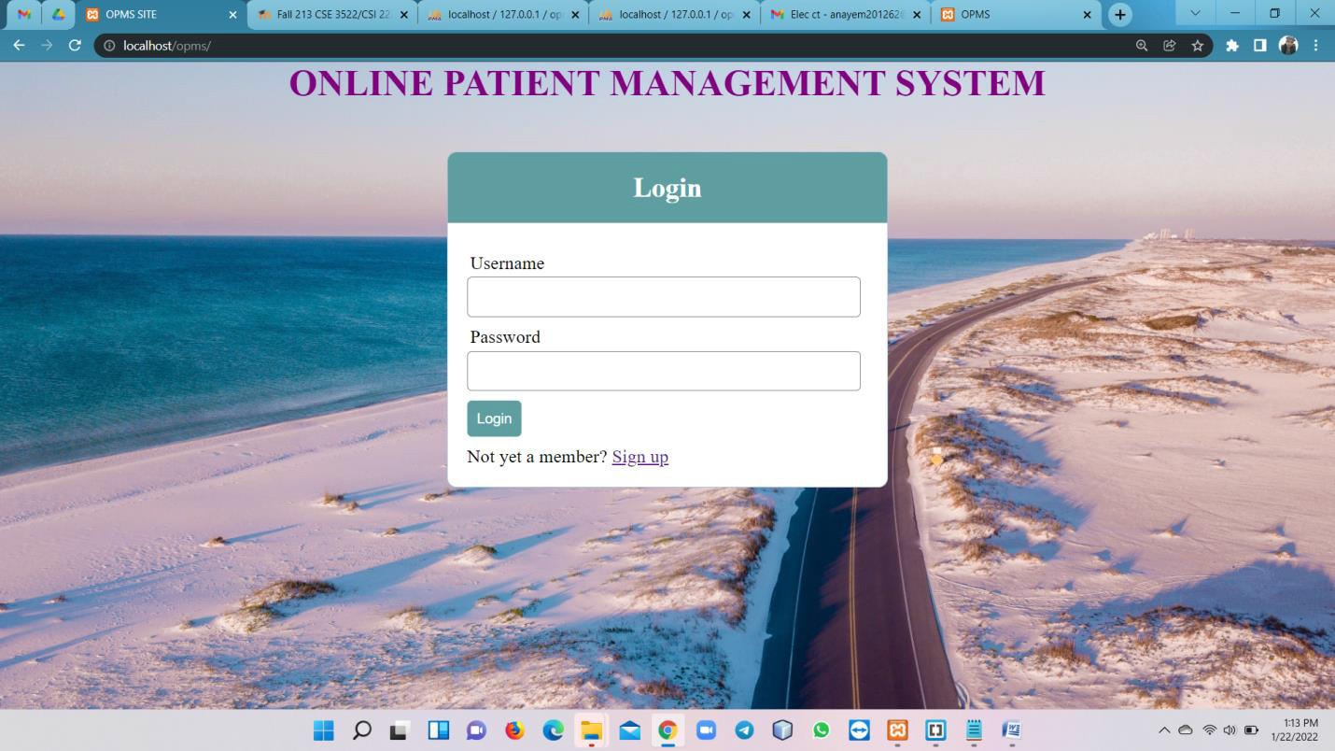
Online Patient Management System
Join:
SELECT p.Payment_id,p.Total_Payment,p.Patient_id,h.H_Code from payment p JOIN history h USING(Payment_id);
SELECT pa.Email,p.Direction,p.Medicine FROM prescription p JOIN patient pa USING(Patient_id);
Pages:

Slide 9
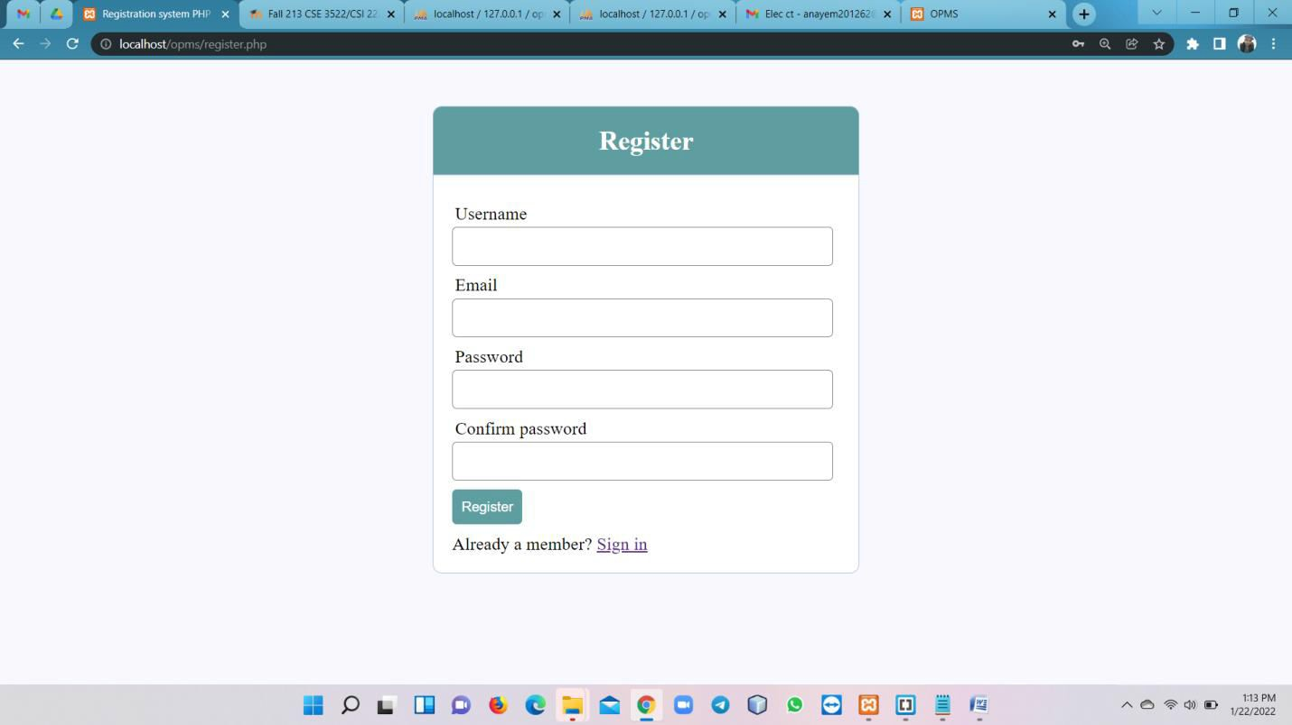
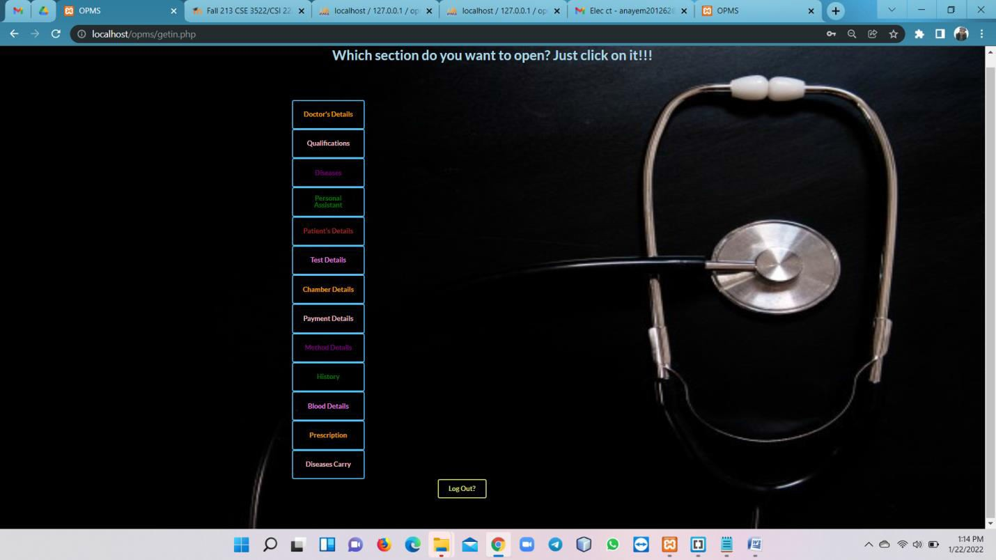
Online Patient Management System

Slide 10
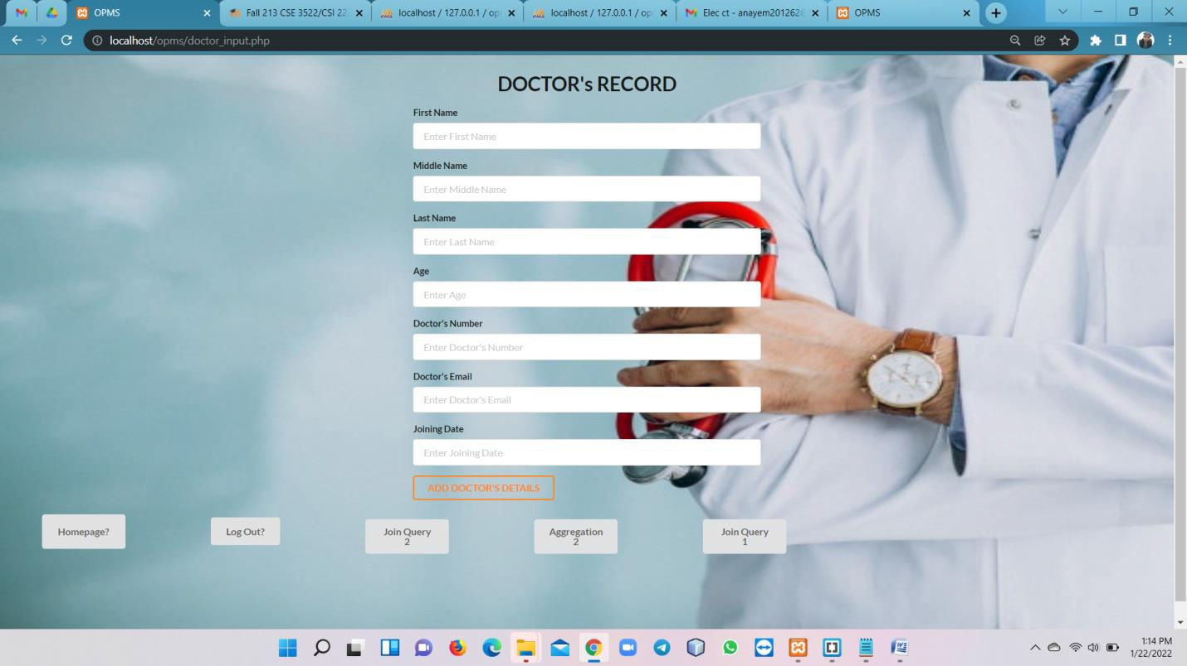
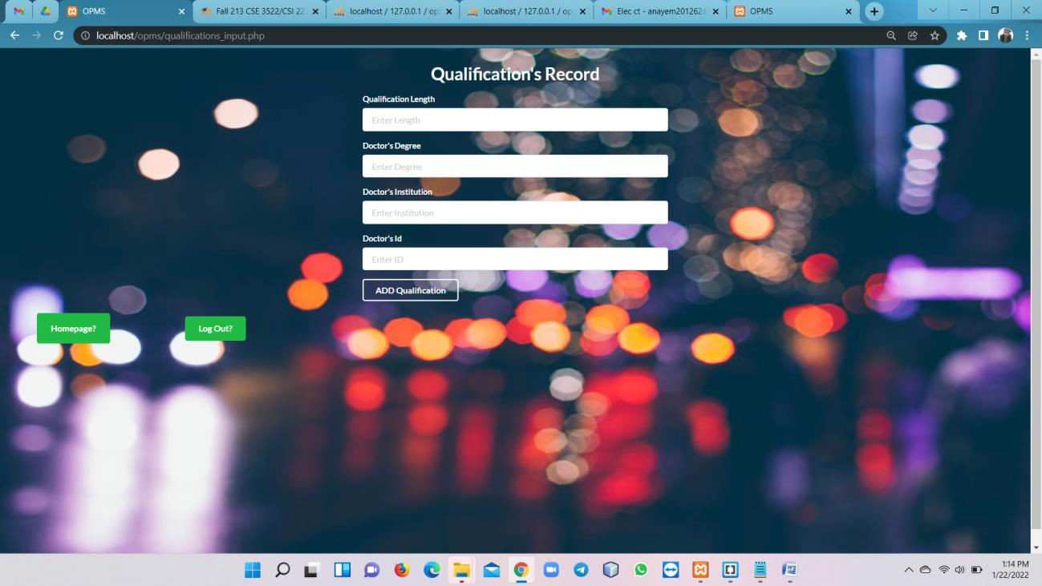
Online Patient Management System

Slide 11
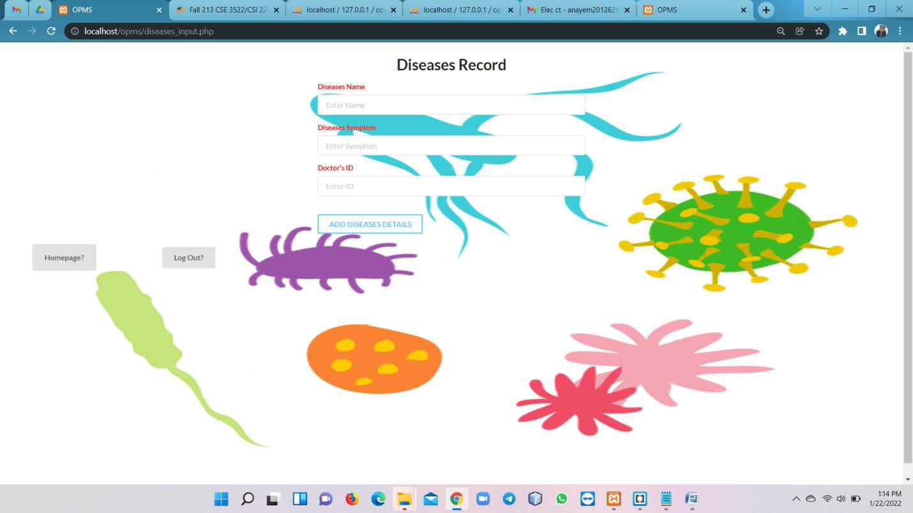
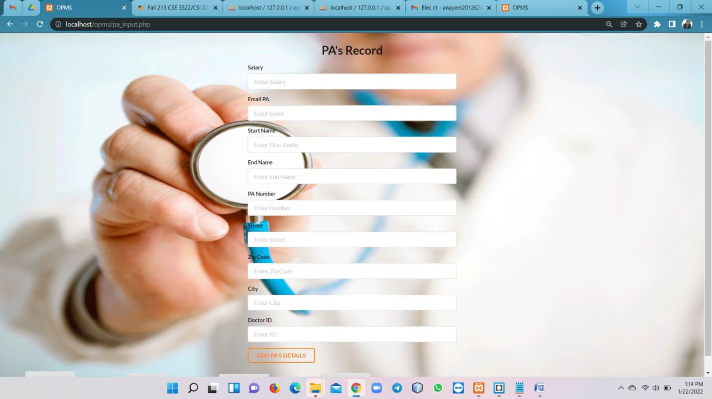
Online Patient Management System

Slide 12
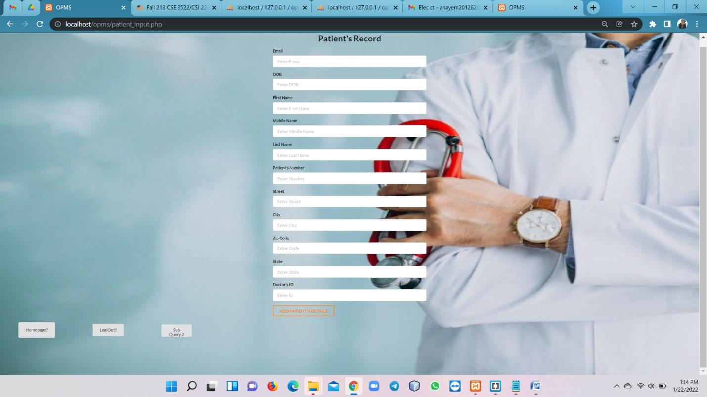
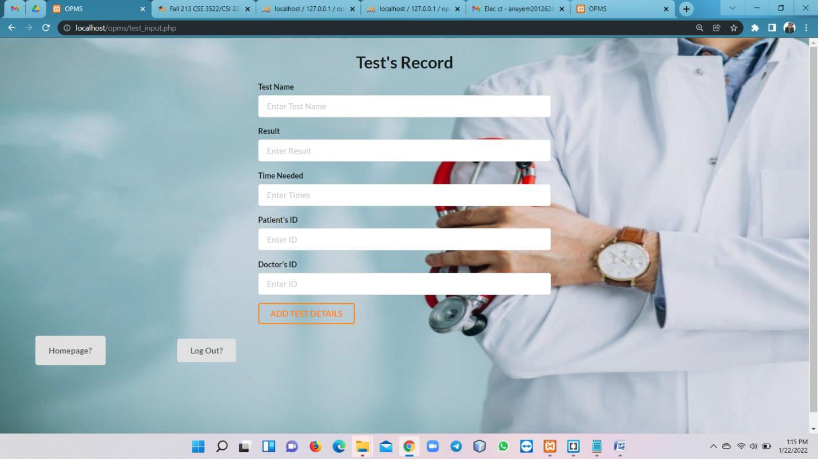
Online Patient Management System

Slide 13
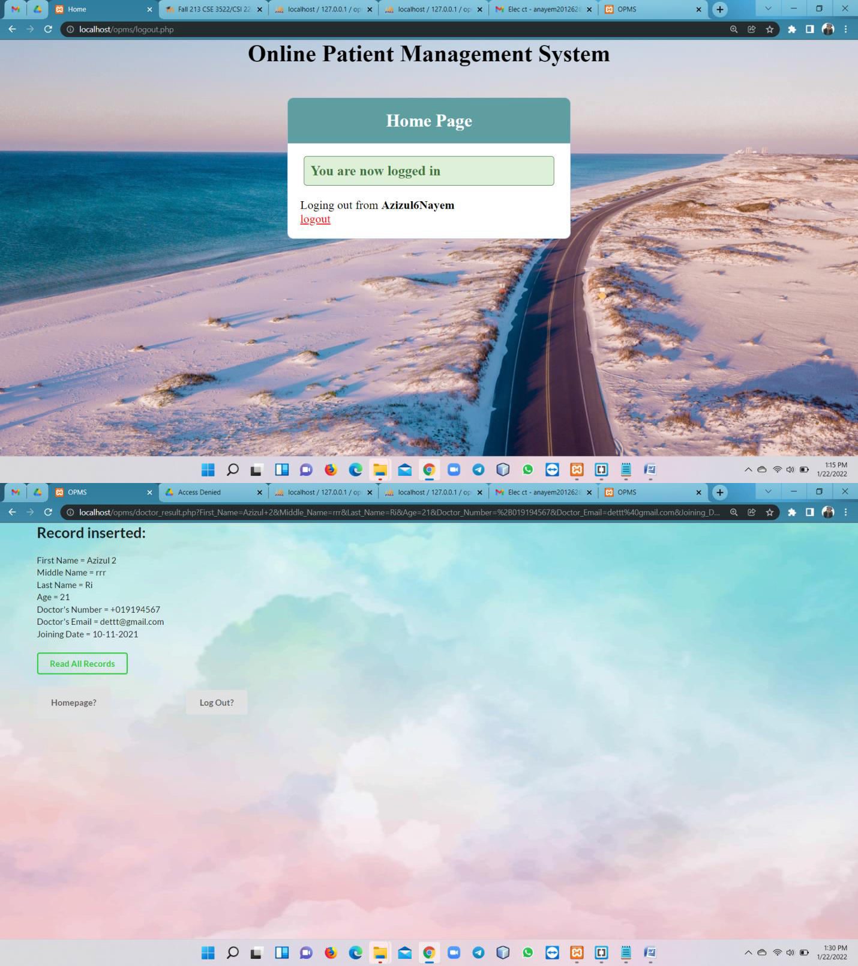
Online Patient Management System

Slide 14
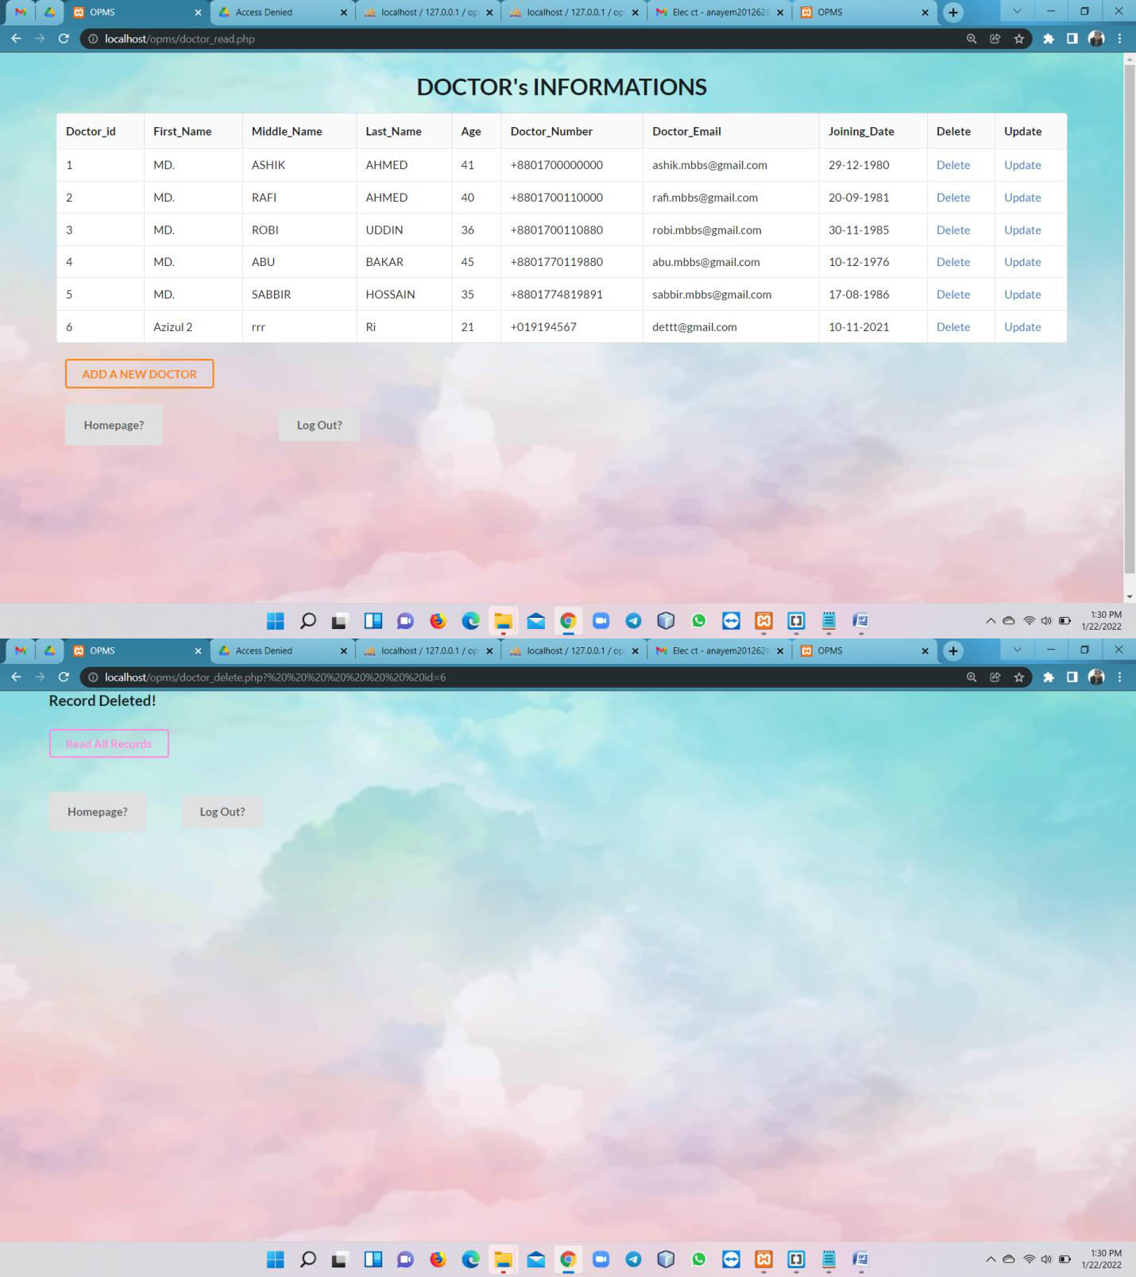
Online Patient Management System

Slide 15
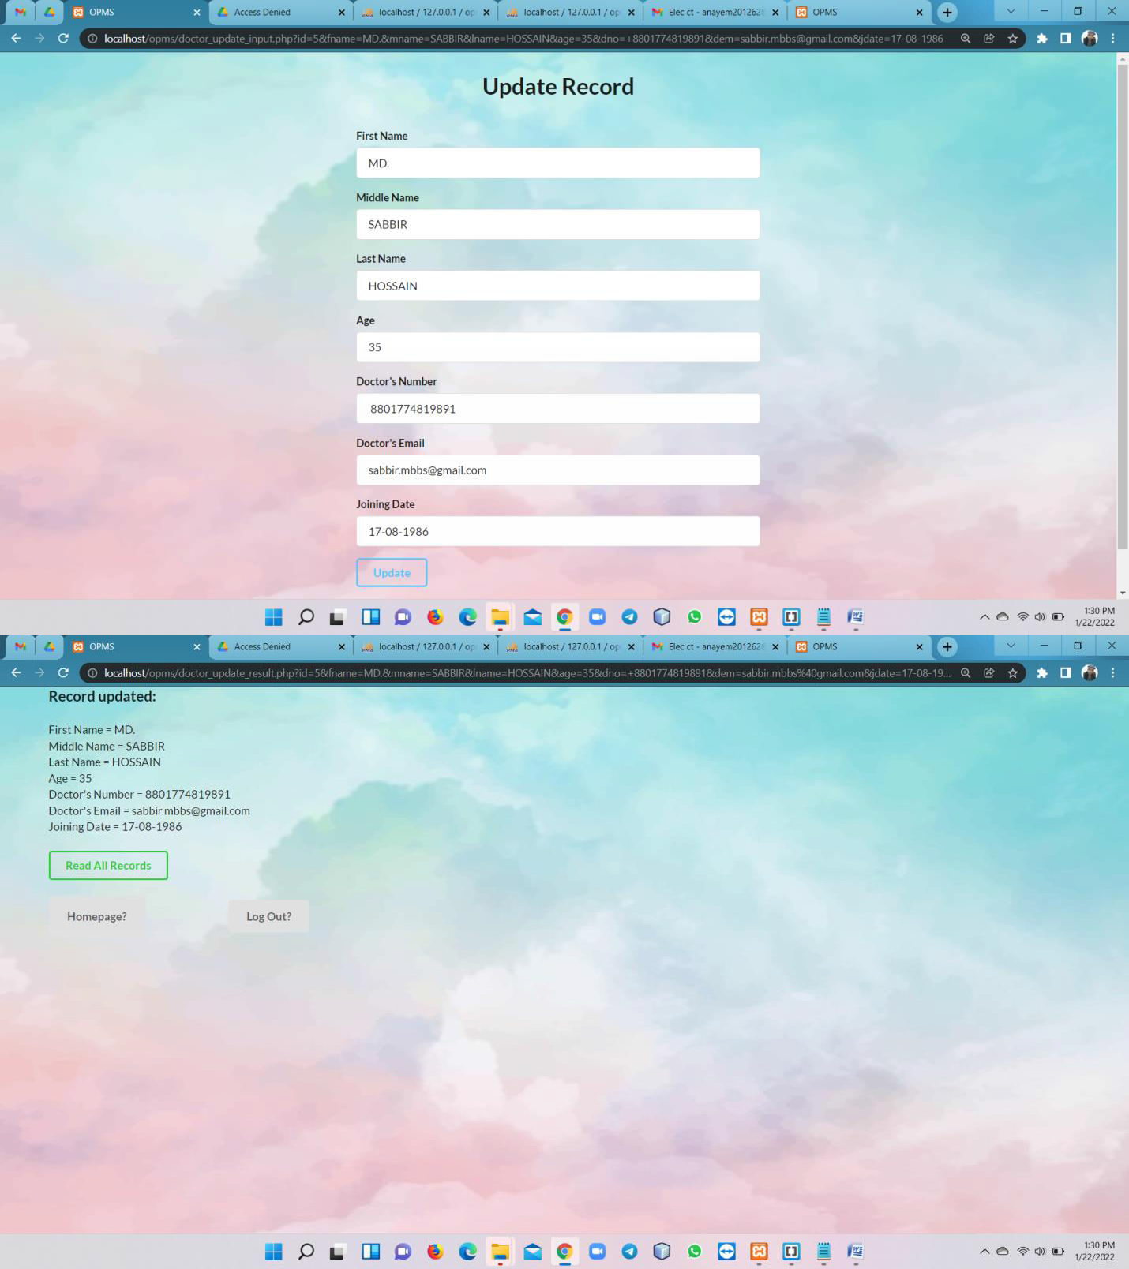
Online Patient Management System

Slide 16
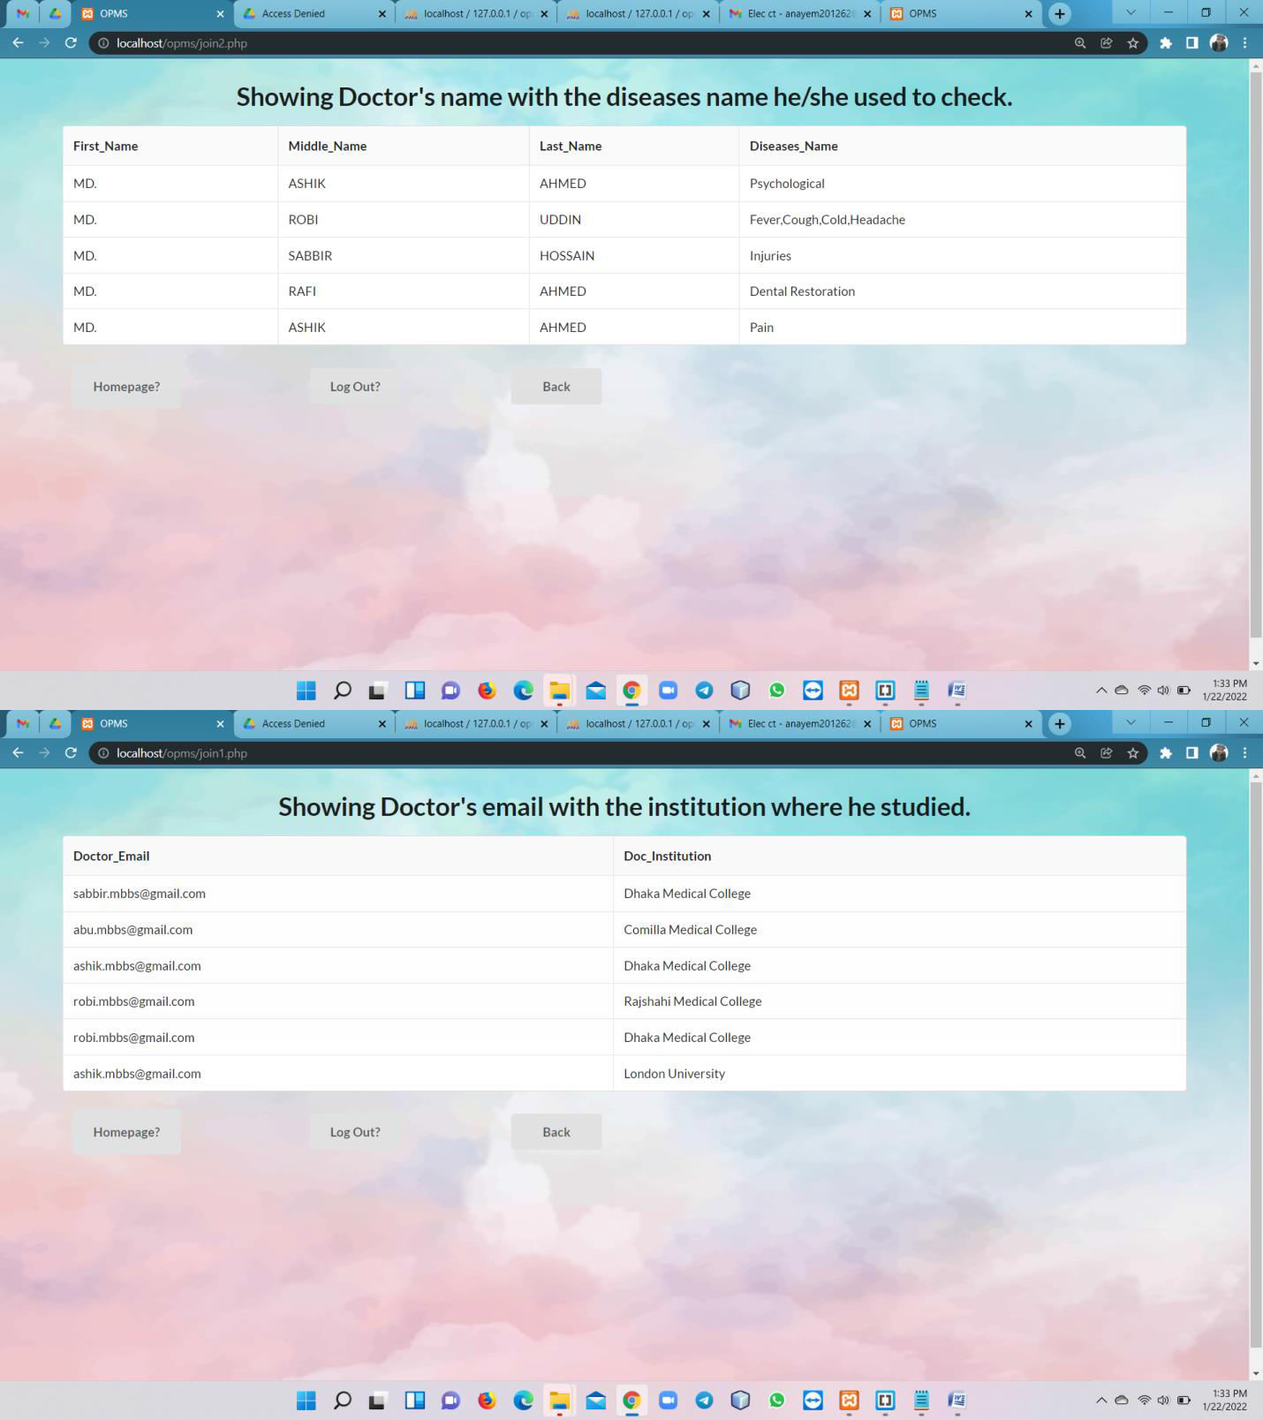
Online Patient Management System

Slide 17
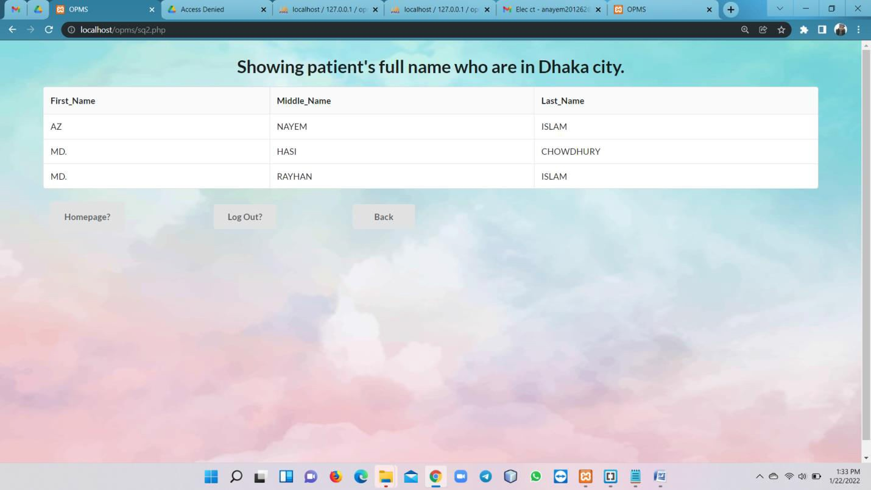
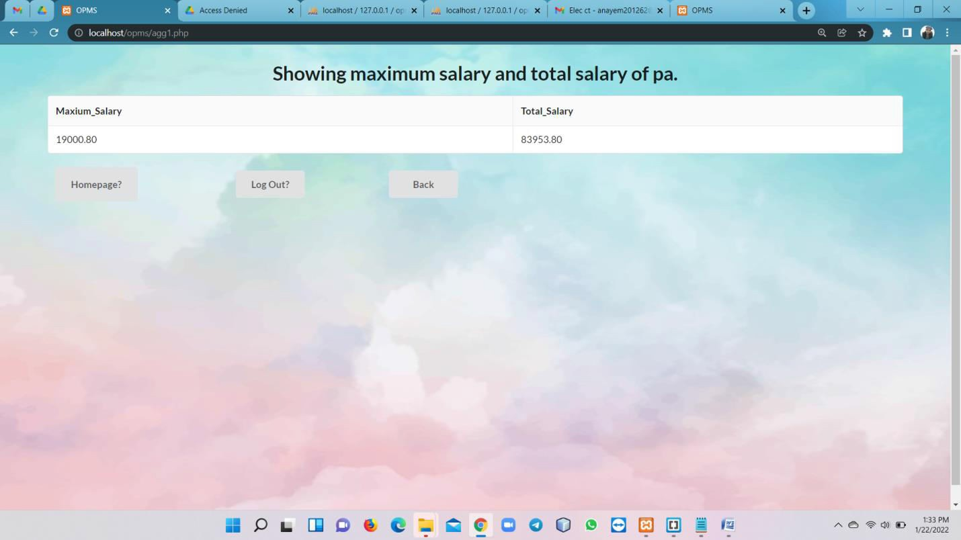
Online Patient Management System

Slide 18
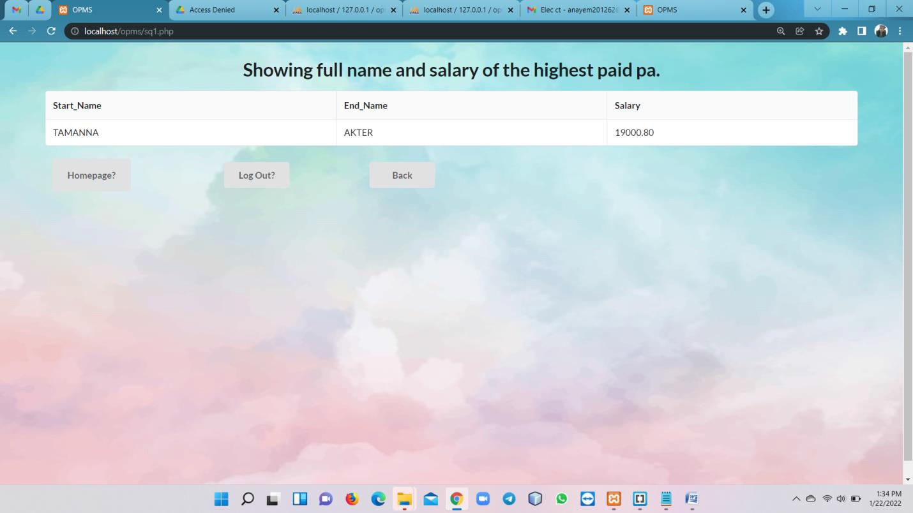
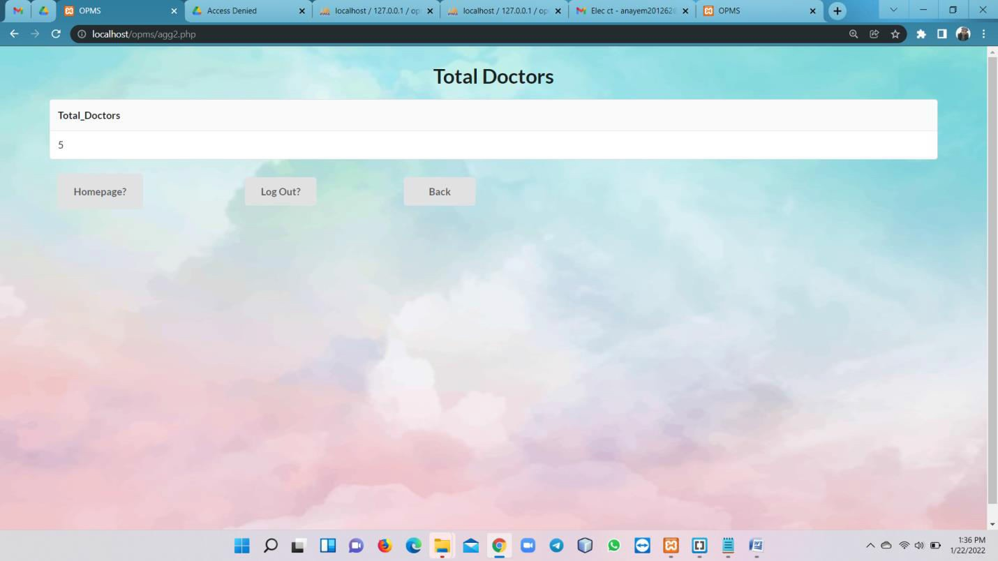
Online Patient Management System

Slide 19
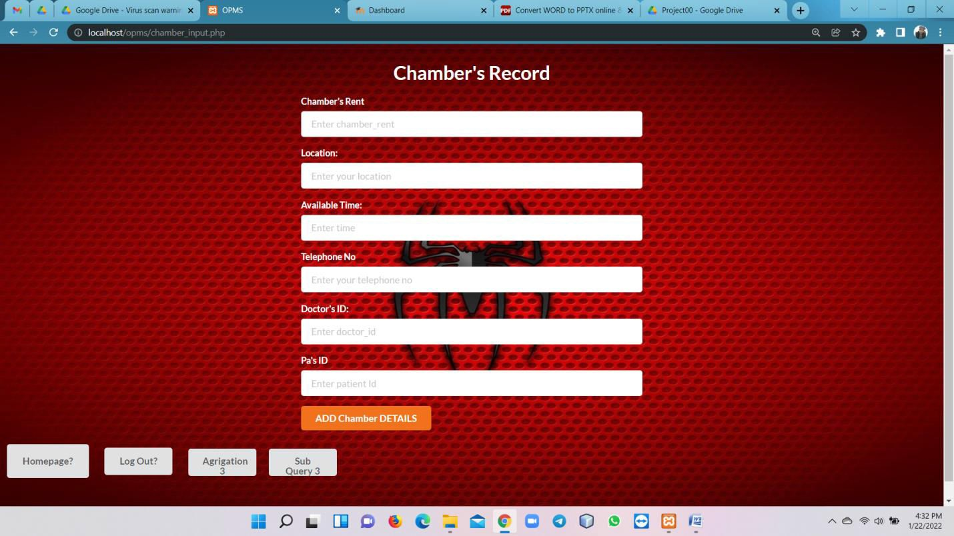
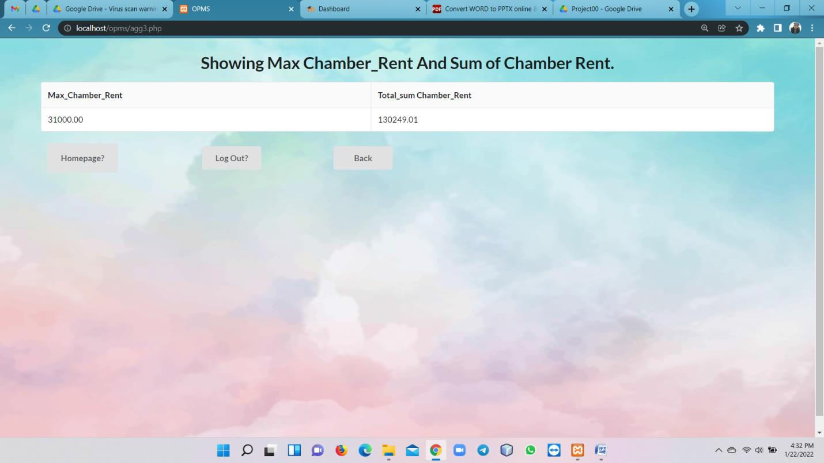
Online Patient Management System

Slide 20
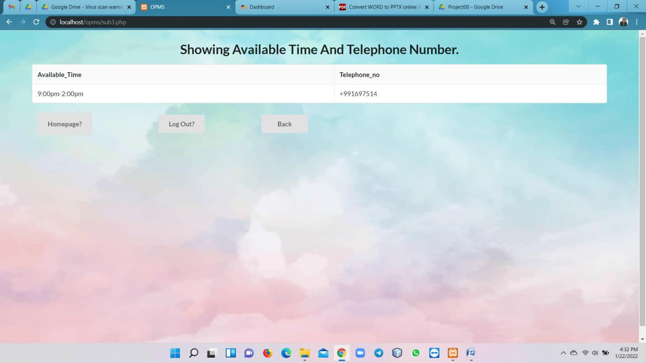
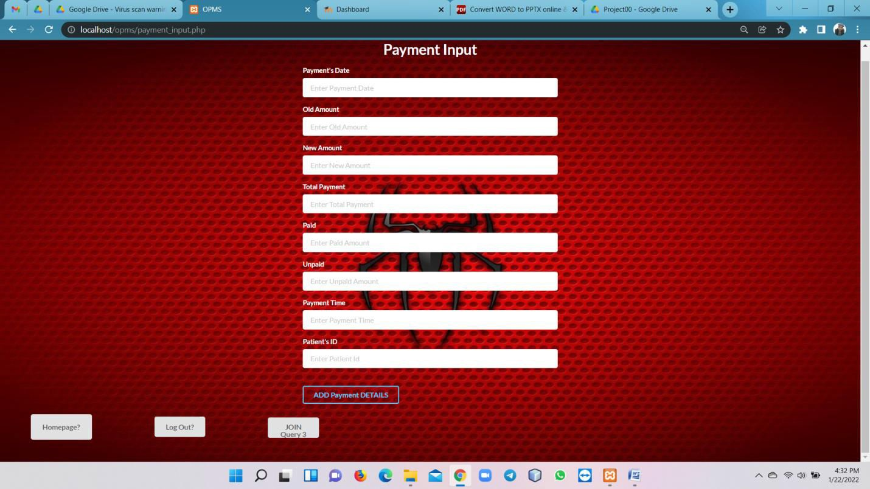
Online Patient Management System

Slide 21
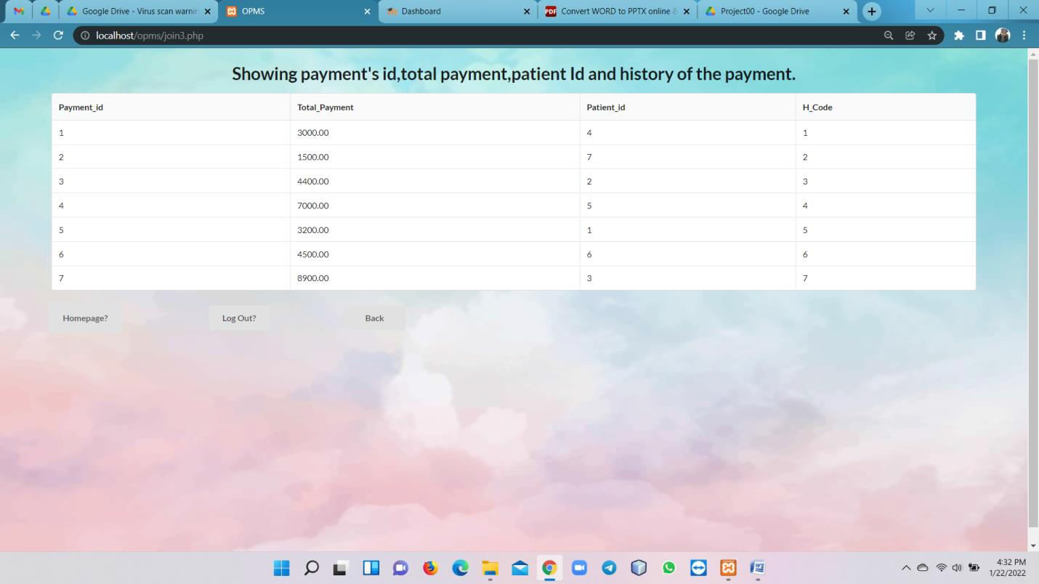
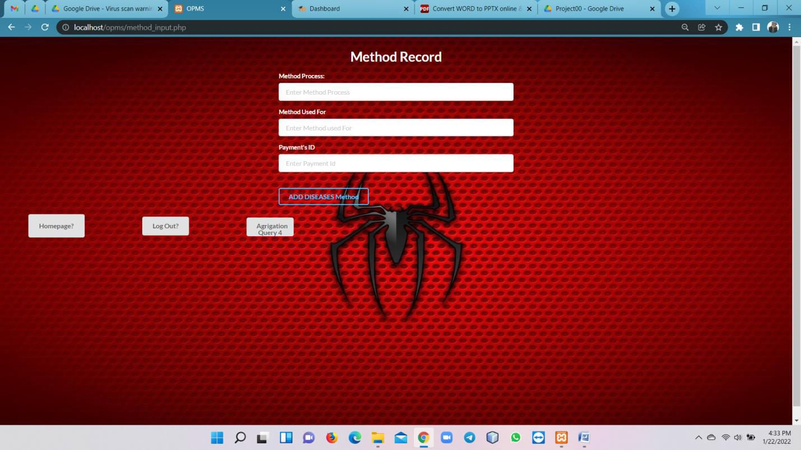
Online Patient Management System

Slide 22
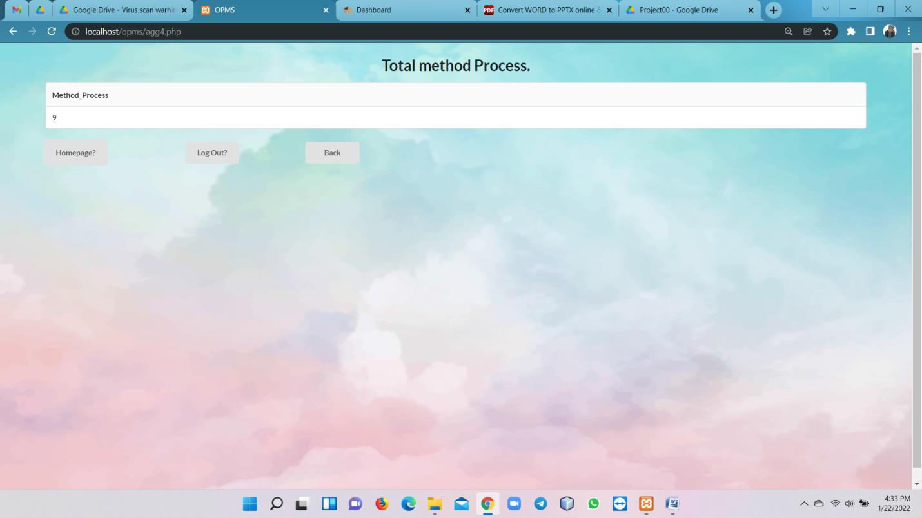
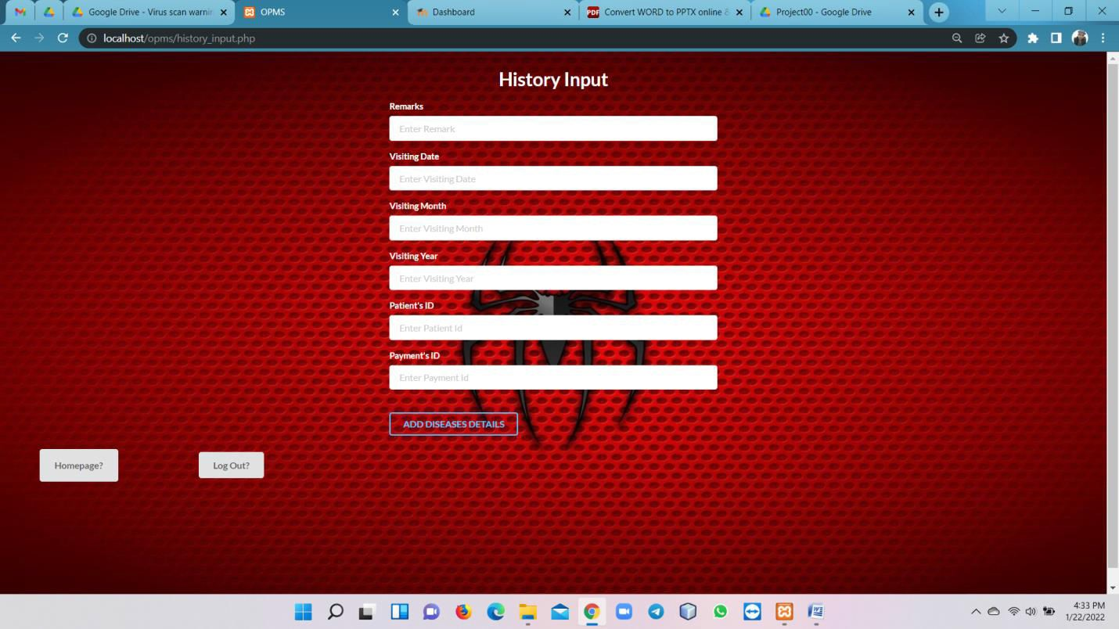
Online Patient Management System

Slide 23
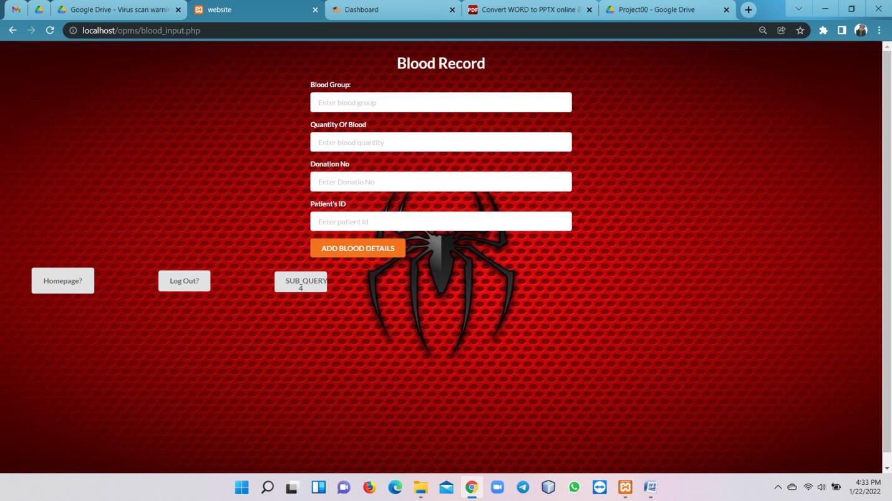
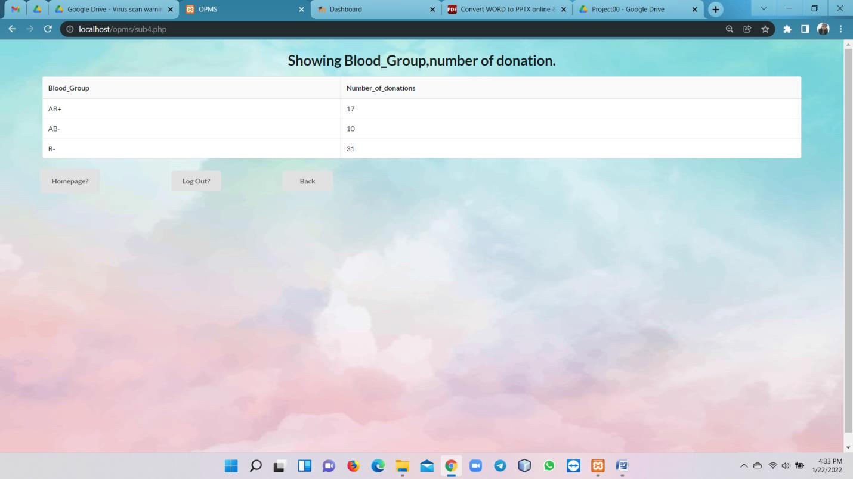
Online Patient Management System

Slide 24
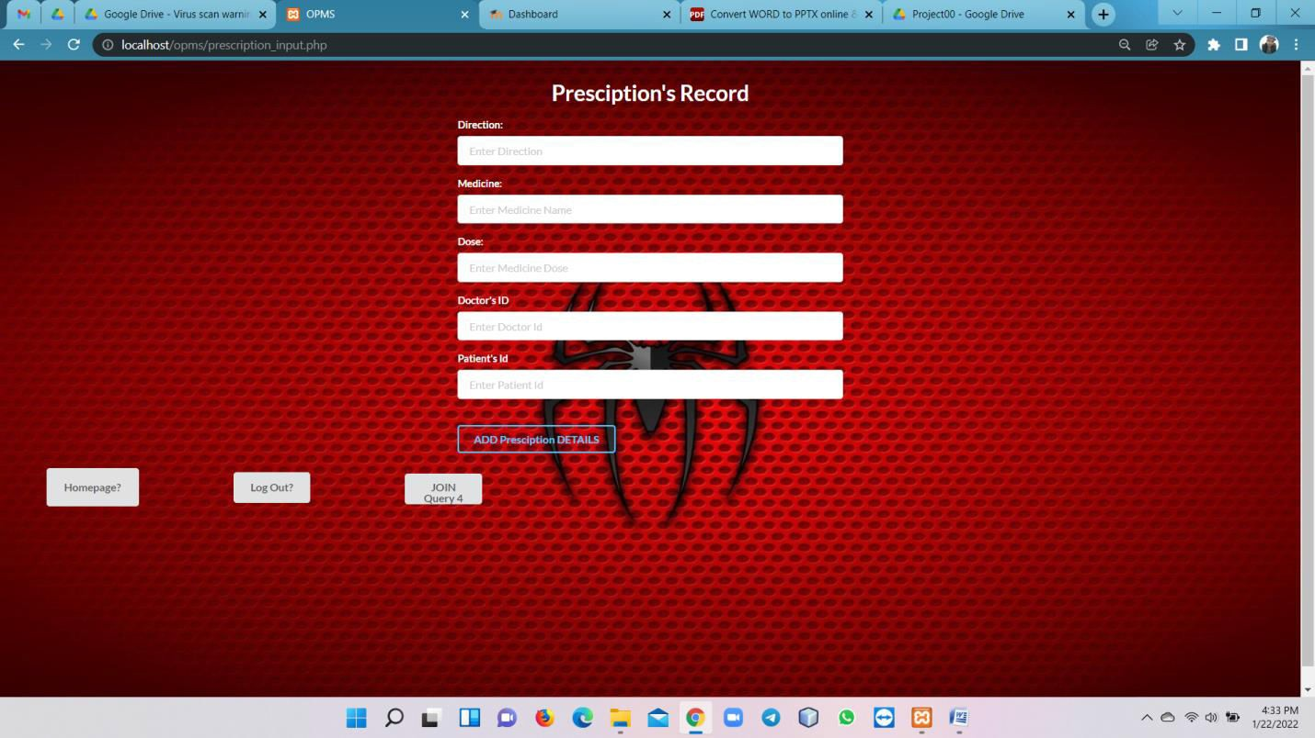
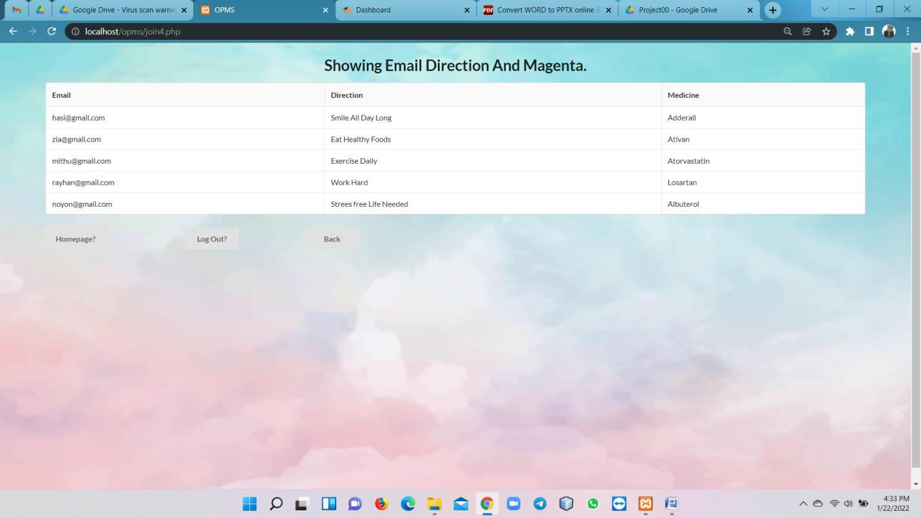
Online Patient Management System

Slide 25
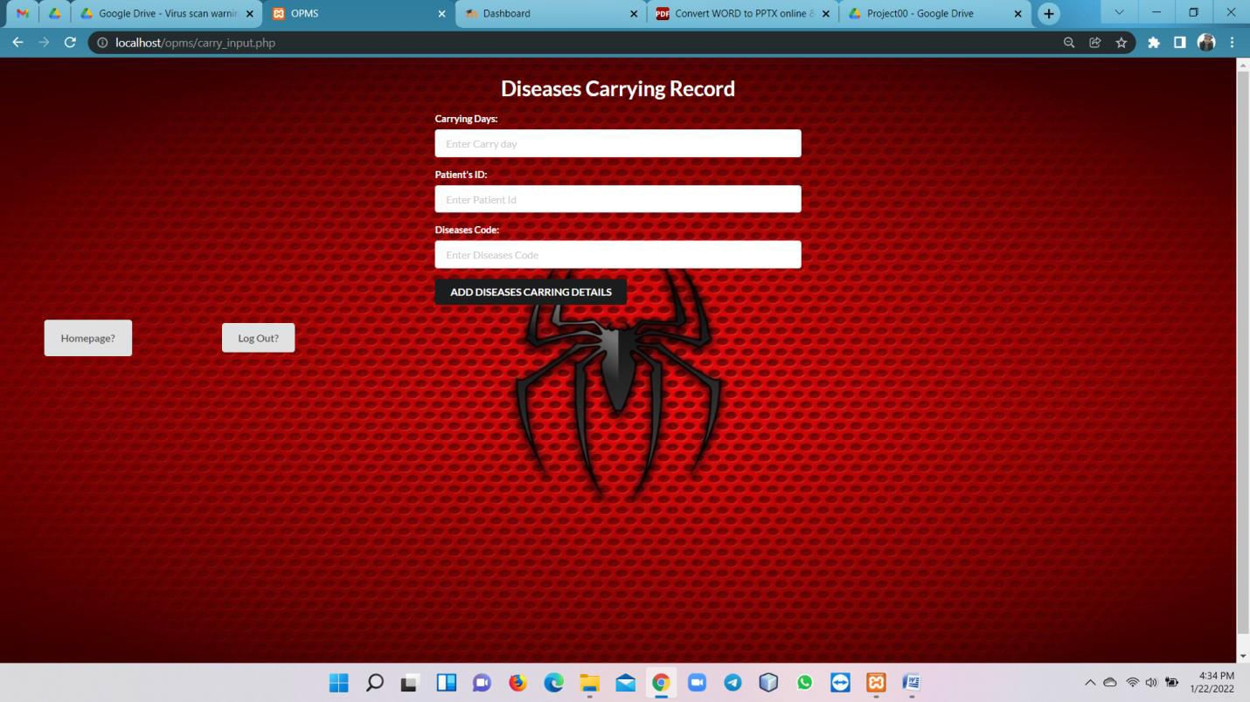
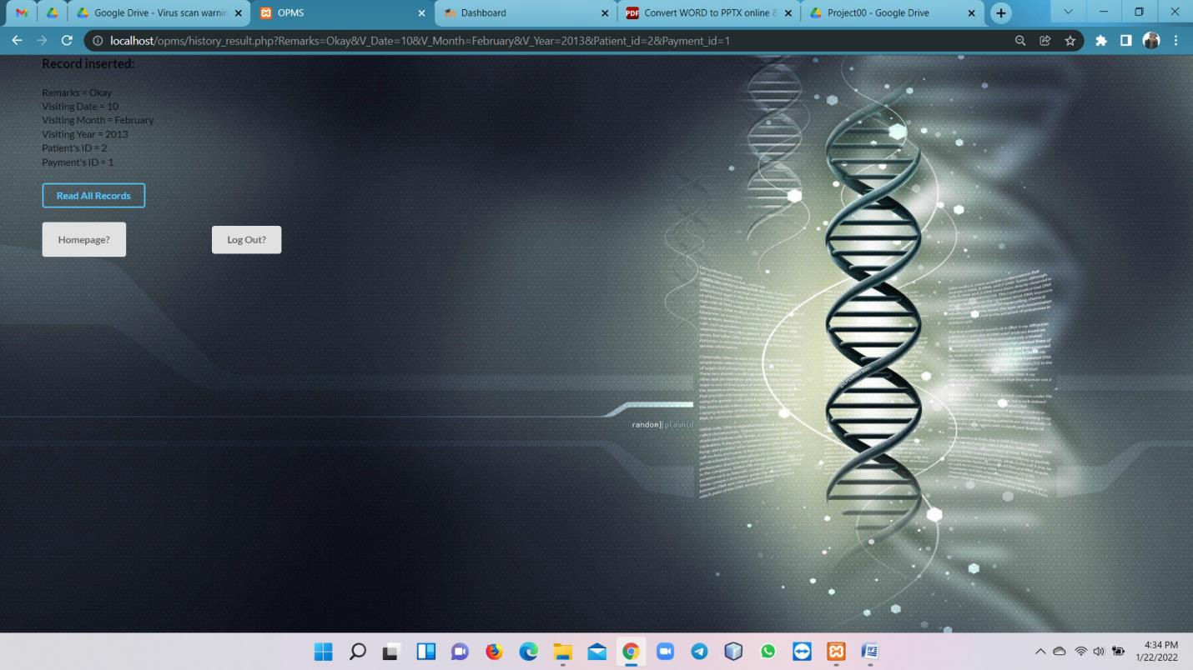
Online Patient Management System

Slide 26
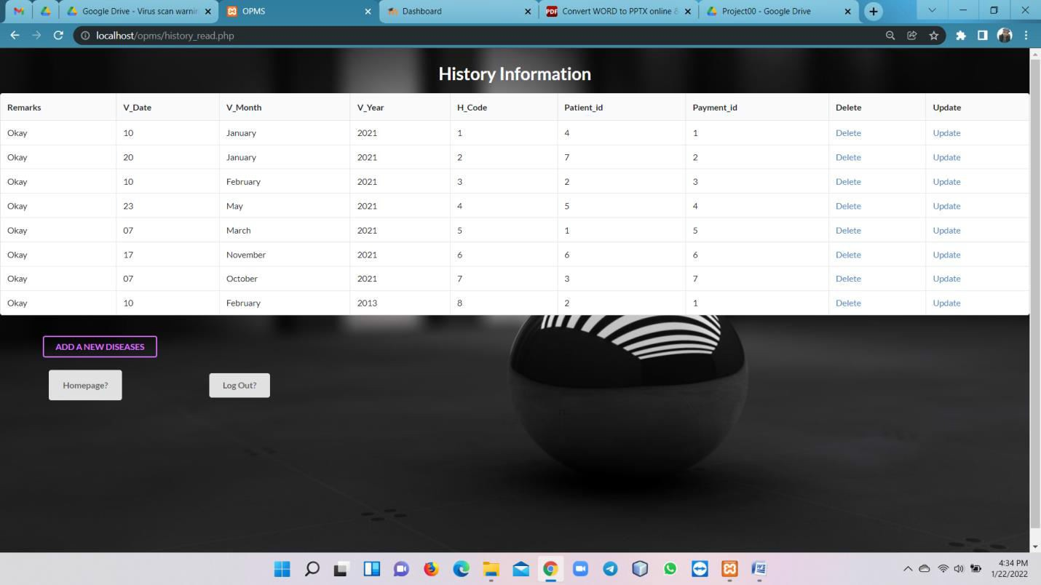
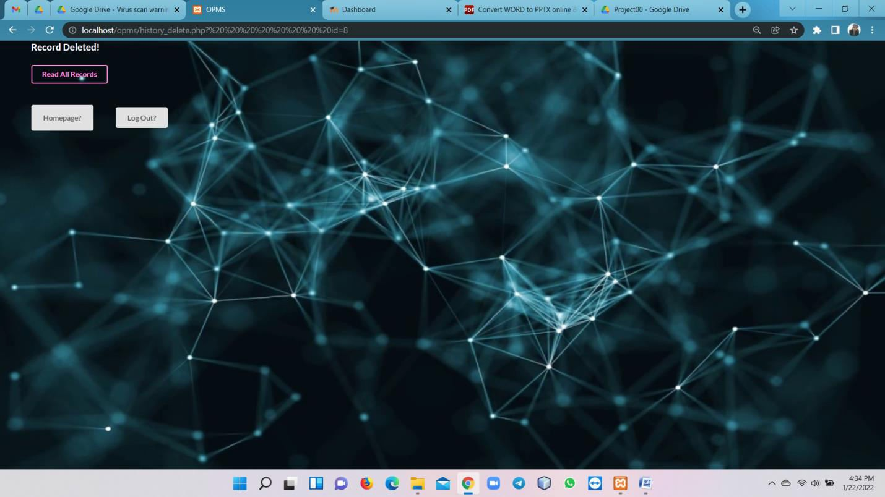
Online Patient Management System

Slide 27
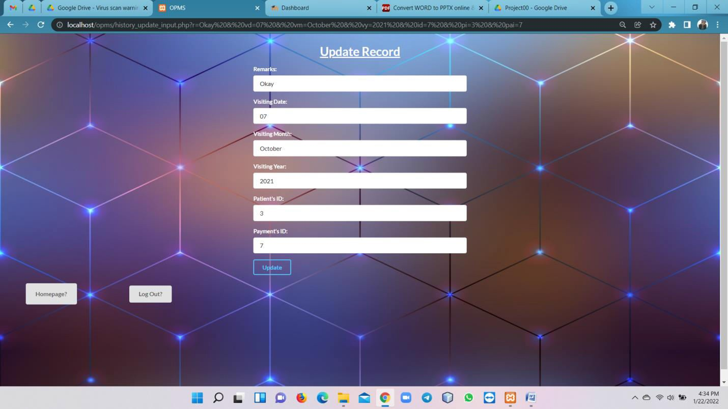
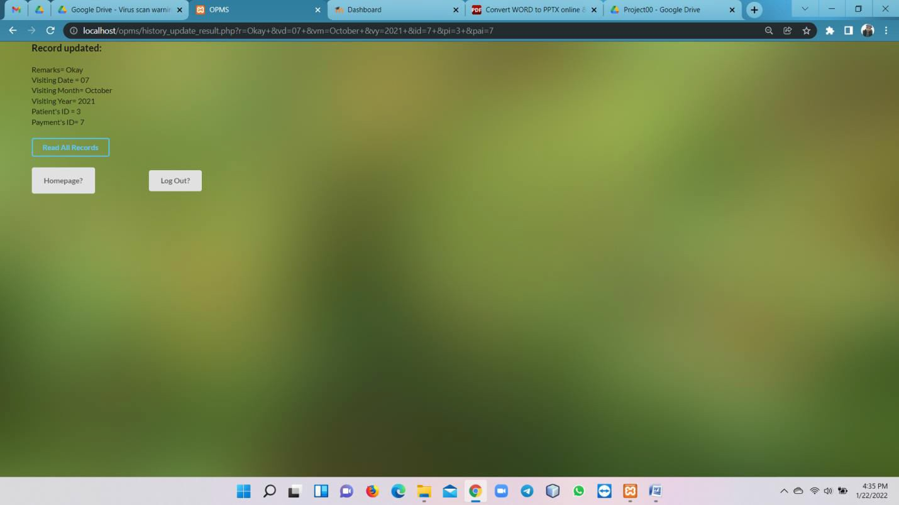

Online Patient Management System

